Slide 1
Social networks
(respiratory pathogens)
Steven Riley
These slides : https://goo.gl/Fr1tGL
Spreadsheet: https://goo.gl/pql2i4
1) Intro 2) important … three reasons 3) biological 4) dynamic …

Slide 2
OBJECTIVES
Be able to describe what contact networks may or may not represent for respiratory pathogens
Be able to describe how data from contact surveys are incorporated into mathematical models
Understand what an eigen vector is and how it is useful in models with age-contact structure
Be able to describe how contact surveys can be extended to help with spatial models
https://goo.gl/Fr1tGL

Slide 3
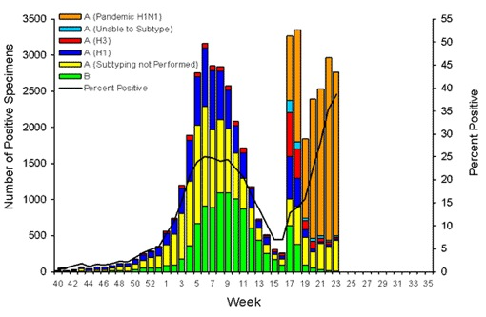
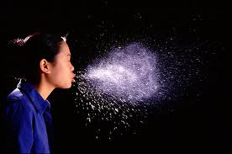

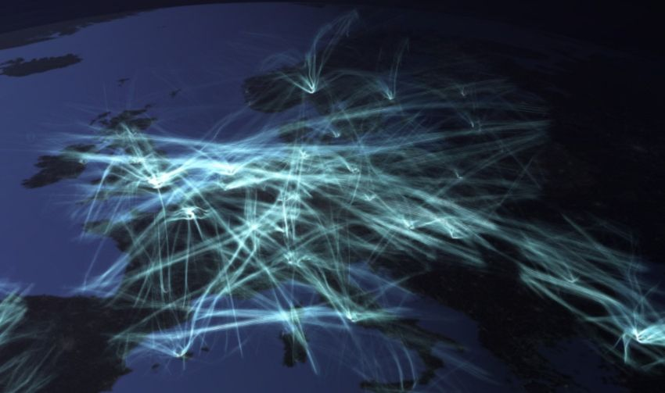
1) Concepts 2) Chart top left 3) You can see 4) Remainder talk 3 processes 5) Actual transmission process 6) One thing we know 7) Therefore human social contact 8) Lets imagine, relative abs
9) fact sharing room Florence 10) Front versus back 11) Relative and abs 12) Larger scales clear 13) Intermediate difficult Piza

Slide 4
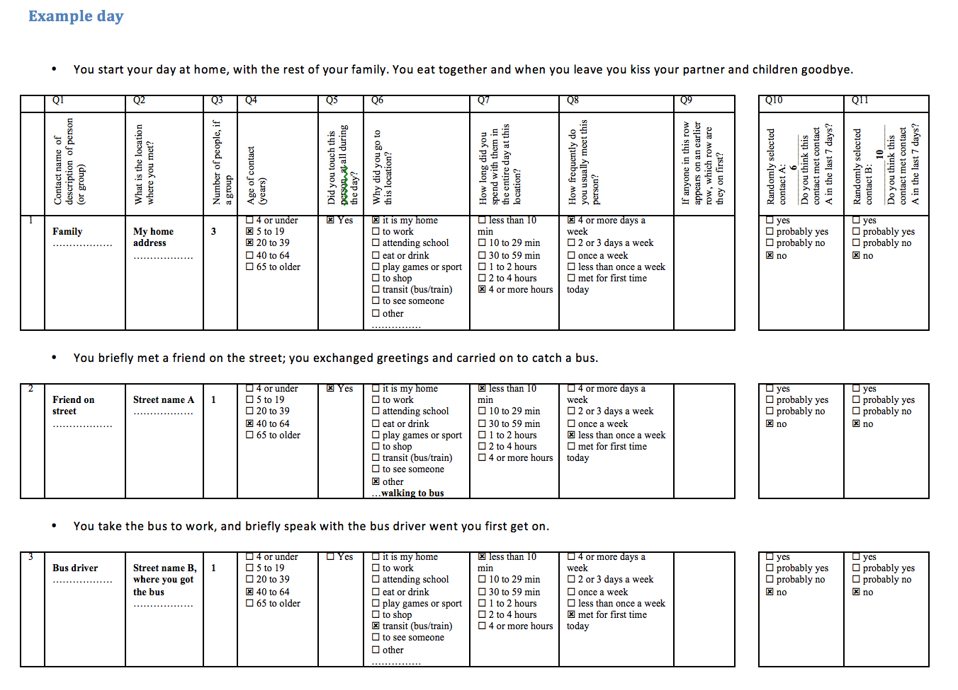
A SELF –REPORTED CONTACT
1) what is a self-reported contact? 2) please don’t read 3) we asked

Slide 5
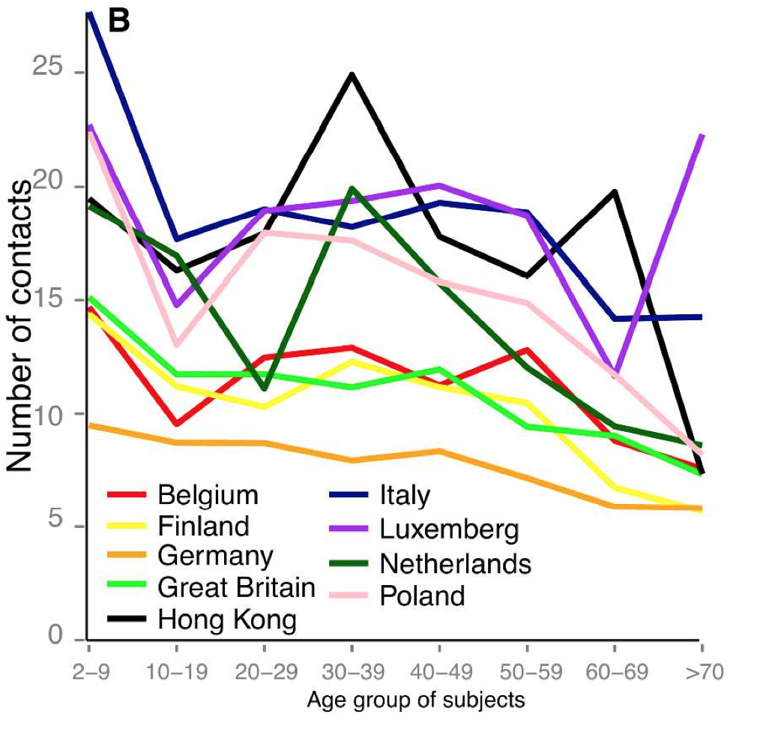
RESULTS BROADLY CONSISTENT WITH PREVIOUS STUDIES
Polymod
Slightly higher numbers (methods)
Similar patterns
Source: Kwok et al, Proc B, 2014

Slide 6
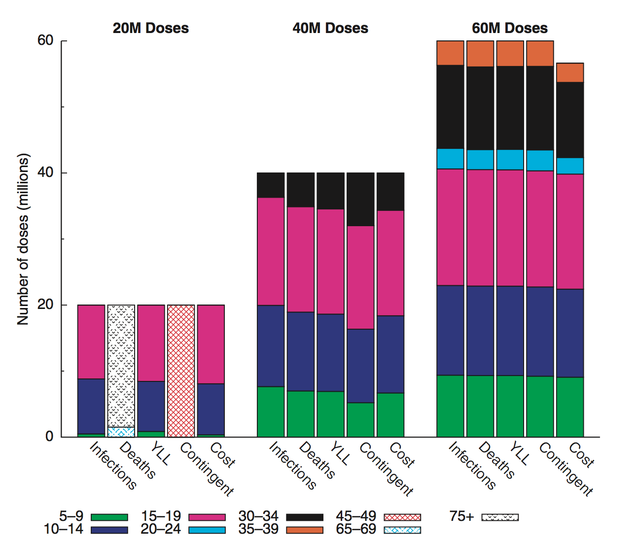
USE IN POLICY
Dynamic models
Health economics
Vaccine prioritization by age
Is the science developed enough?
Source: Medlock and Galvani, Science, 2009

Slide 7
OBJECTIVES
Be able to describe what contact networks may or may not represent for respiratory pathogens
Be able to describe how data from contact surveys are incorporated into mathematical models
Understand what an eigen vector is and how it is useful in models with age-contact structure
Be able to describe how contact surveys can be extended to help with spatial models

Slide 8
MODEL STRUCTURE
S_{a}
I_{a}
R_{a}
S_{c}
I_{c}
R_{c}

Slide 9
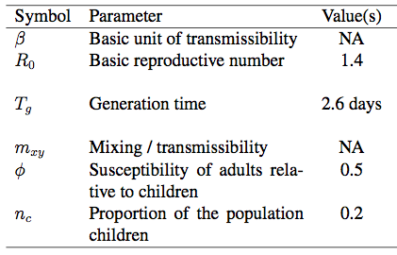
PARAMETERS

Slide 10
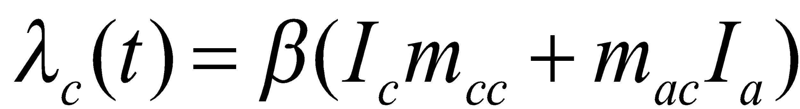
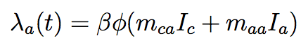
FORCE OF INFECTION
Source: Riley et al, in prep.

Slide 11
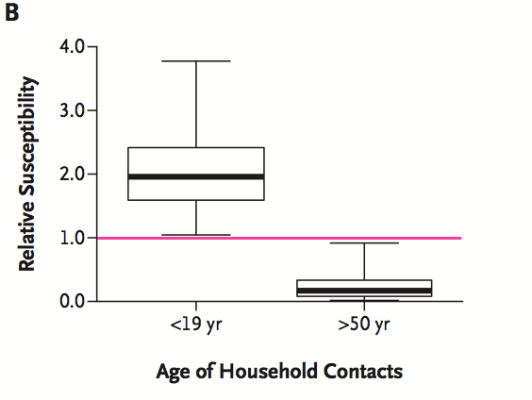
AGE-SPECIFIC SUSCEPTIBILITY
Source: Cauchemez et al, NEJM, 2010

Slide 12
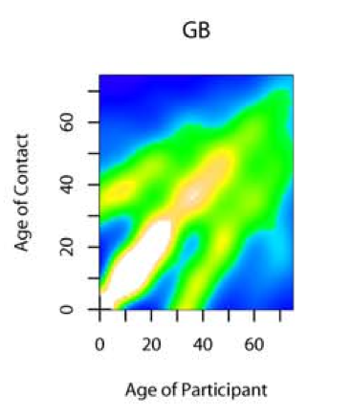
PLOYMOD-TYPE MIXING
Source: Mossong et al, PLoS Med, 2008

Slide 13
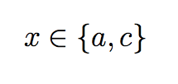
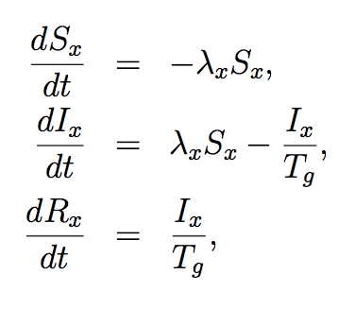
MODEL EQUATIONS
Source: Riley et al, in prep.

Slide 14
OBJECTIVES
Be able to describe what contact networks may or may not represent for respiratory pathogens
Be able to describe how data from contact surveys are incorporated into mathematical models
Understand what an eigen vector is and how it is useful in models with age-contact structure
Be able to describe how contact surveys can be extended to help with spatial models

Slide 15
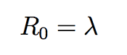
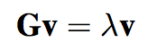
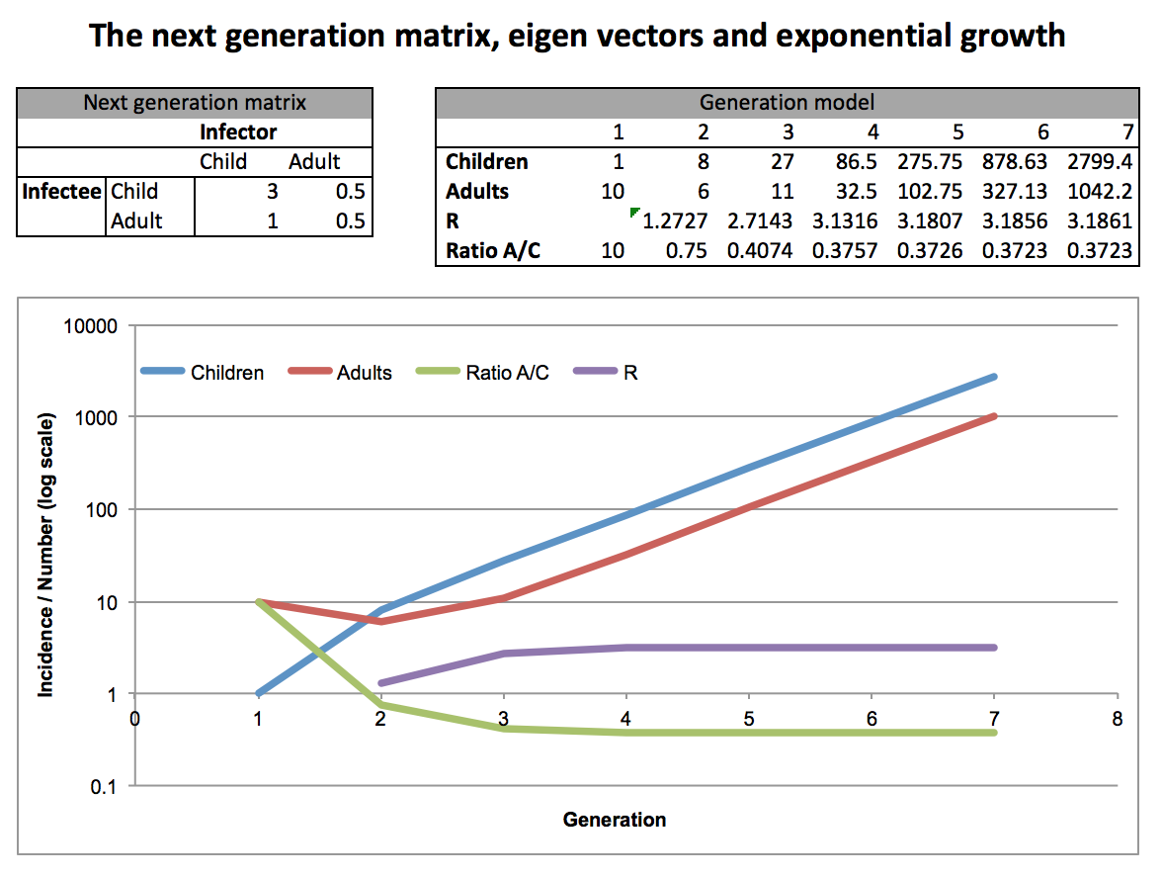
BASIC REPRODUCTIVE NUMBER
See also: Heesterbeek and Roberts, Math Bio, 2004

Slide 16
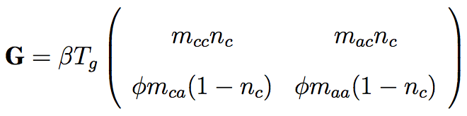
NEXT GENERATION MATRIX
Infector
Infectee
Source: Heesterbeek and Roberts, Math Bio, 2004

Slide 17
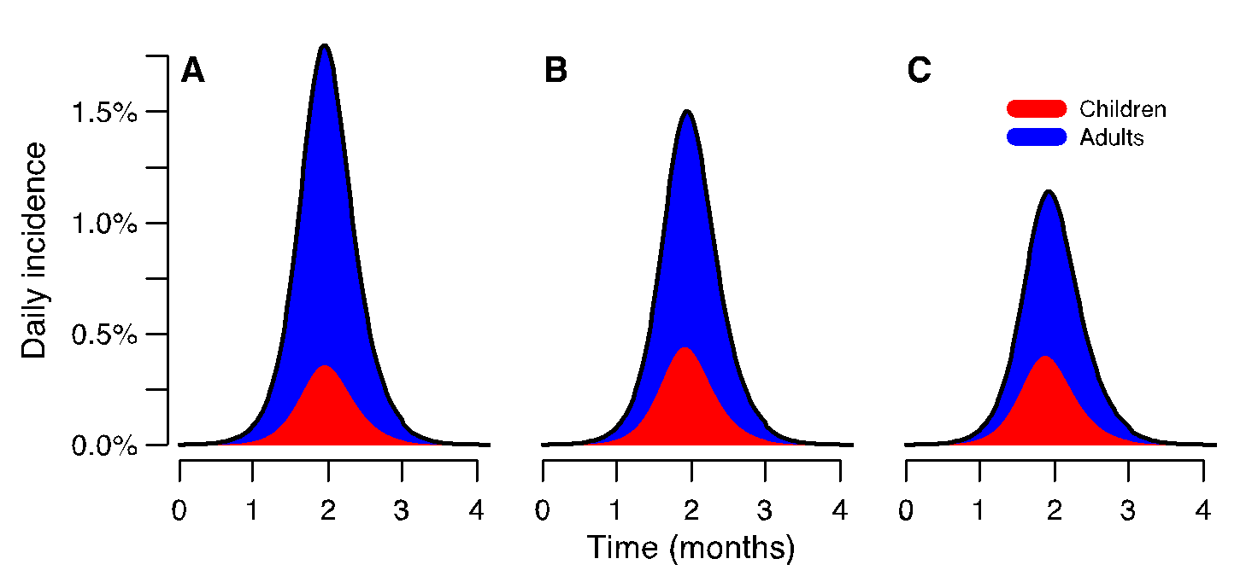
DRIVERS OF PEAK INCIDENCE
Reduced susceptibility
of adults and “polymod-type” mixing
Fully mass action
Reduced susceptibility
of adults
Source: Riley et al, in prep.
Comments: R0 and initial incidence the same – peaks different

Slide 18
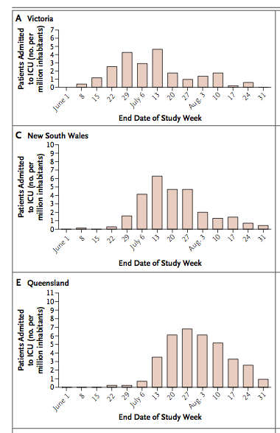
INTERPRETING PEAK INCIDENCE
But how many infections
produced an ICU case?
Source:ANZIC Influenza Investigators, NEJM, 2009

Slide 19
OBJECTIVES
Be able to describe what contact networks may or may not represent for respiratory pathogens
Be able to describe how data from contact surveys are incorporated into mathematical models
Understand what an eigen vector is and how it is useful in models with age-contact structure
Be able to describe how contact surveys can be extended to help with spatial models

Slide 20
A SELF –REPORTED CONTACT
1) here is the contact questionnaire again 2) wewere able to extract locations from this 3) the study team made a map 4) made a list of unique location ids for each community

Slide 21
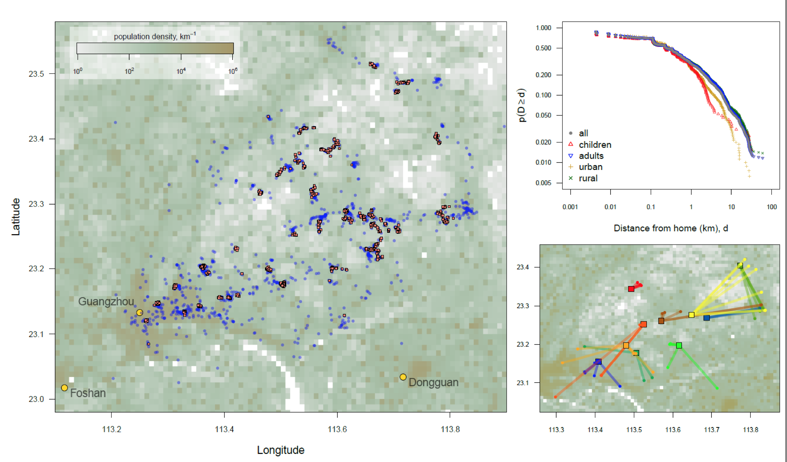
STUDY DATA
Source: Read et al, Proc B, 2014
1) different study 2) fluscape 3) 40 locations in and around GZ in southern china 4) we asked them… 5) the main chart 6) examples on the lower chart 7) these produced nice smooth curves

Slide 22
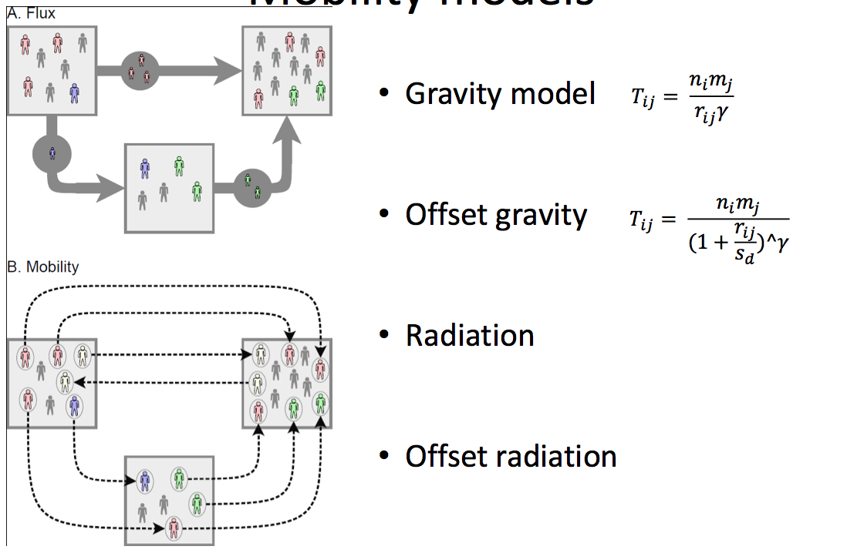
FLUX VERSUS MOBILITY (OUR TERMS)
Flux is the number of people going from one place to another
Mobility is a model of how an individual behaves
A mobility model uniquely specifies a flux model
Mobility models are defined up to arbitrarily high resolution
Census subset data gives you flux directly
Survey data gives you mobility
Source: Read Mills et al, In prep.

Slide 23
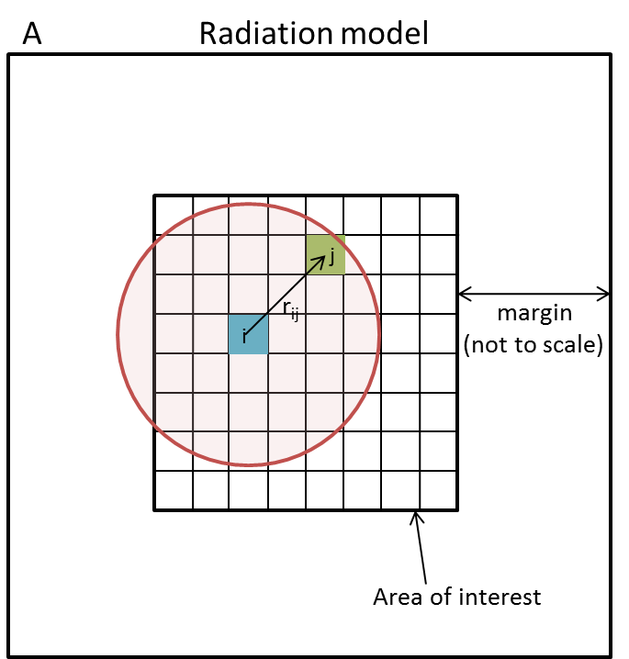
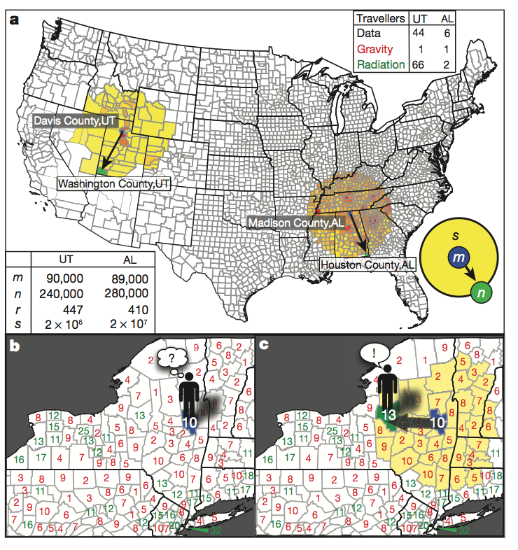
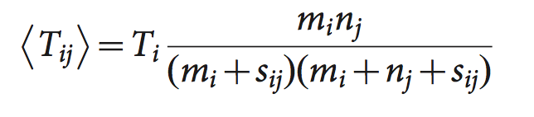
RADIATION AS A FLUX MODEL
Source: Simini, Science, 2013
1) Very influential, not just ID 1A) suggests universal parameter free flux model 2) models of us commuting 3) called radiation because intermediate people absorb opportunities 4) the s term

Slide 24
FLUX VERSUS MOBILITY
MOBILITY ASSUMPTIONS
Source: Read Mills et al, In prep.
1) We define gravity as a mobility model and calculate the relative probability 2) we also consider an offset version TYPO 3) the offset version allows a plateua

Slide 25
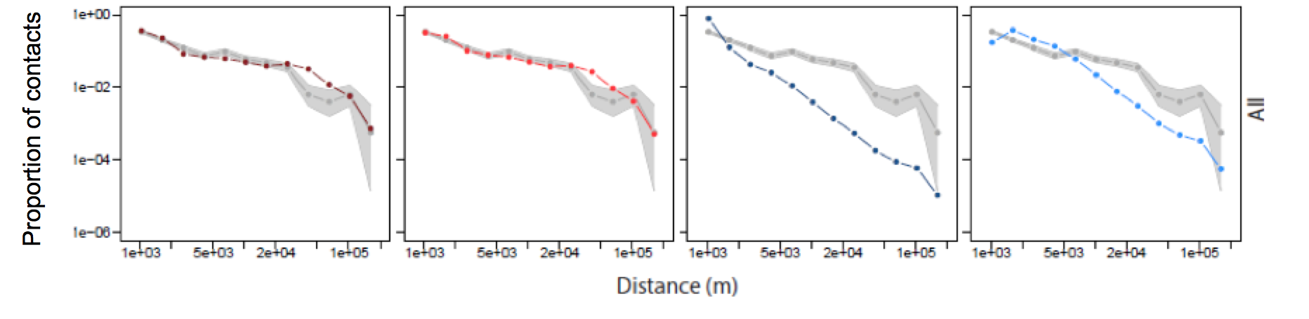
ALL STUDY PARTICIPANTS
Gravity
Offset gravity
Radiation
Offset radiation
Source: Read Mills et al, In prep.
1) Generally, offset does best… 2) here it’s a small difference in the small distances 3) radiation and offset radiation both do poorly

Slide 26
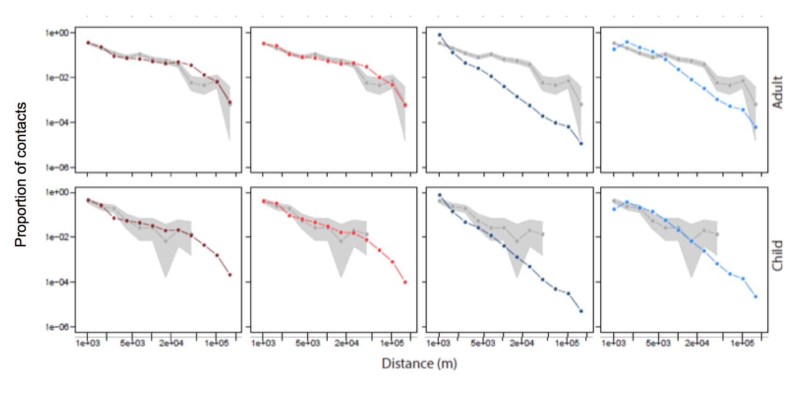
CHILDREN VERSUS ADULTS
Gravity
Offset gravity
Radiation
Offset radiation
Source: Read Mills et al, In prep.
1) We can also stratify by children and adults 2) same relationships are maintained 3) for children, the radiation isn’t aweful 4) probably because the model basically holds for school?

Slide 27
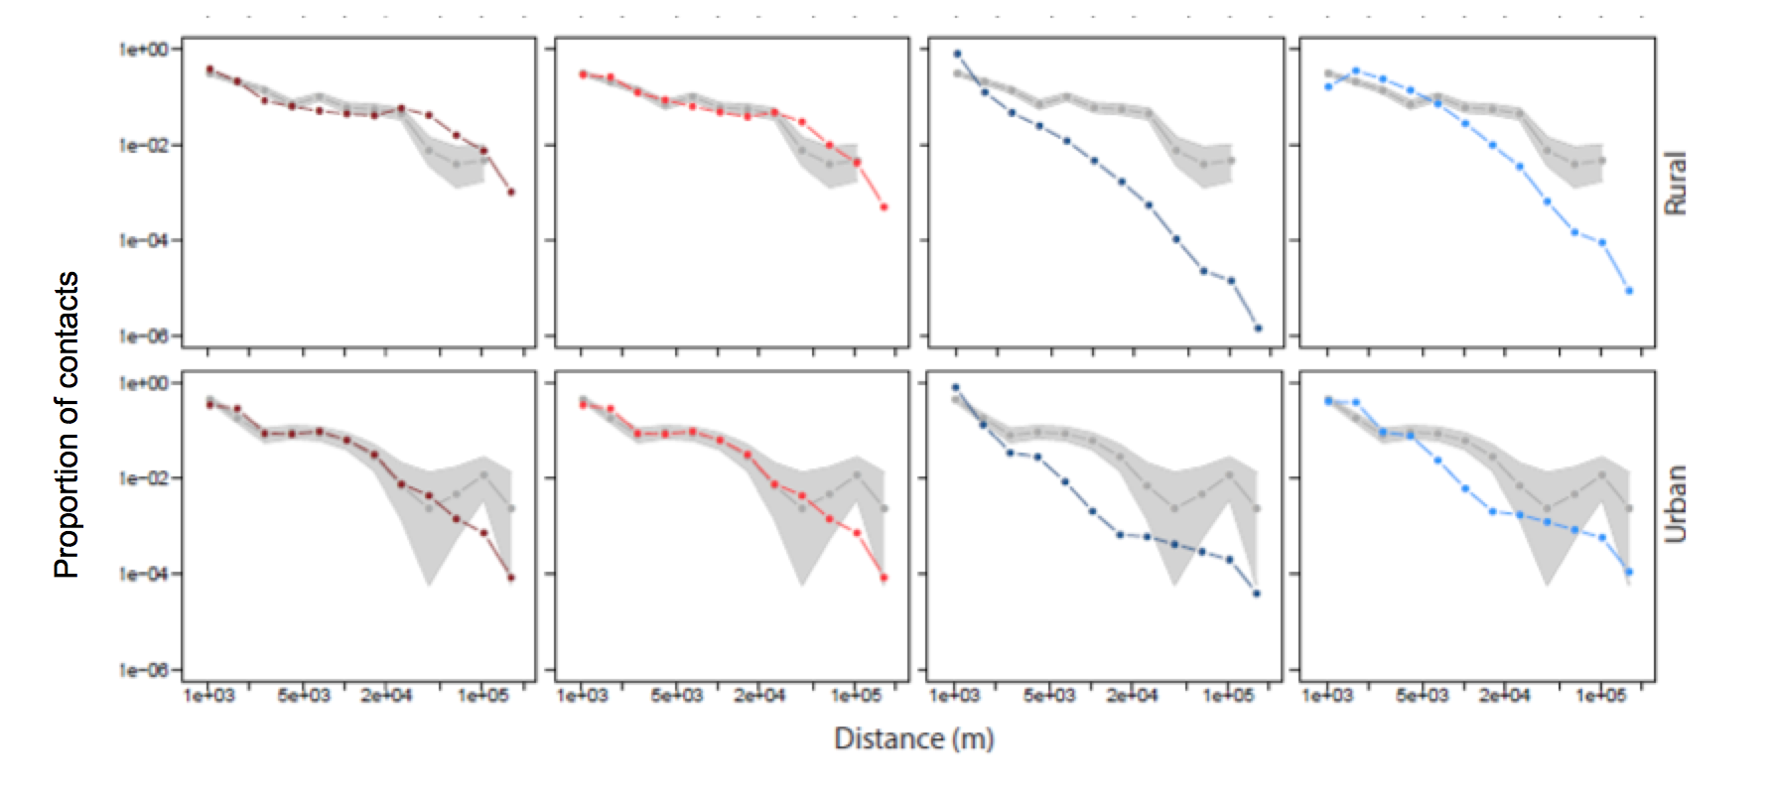
RURAL VERSUS URBAN
Gravity
Offset gravity
Radiation
Offset radiation
Source: Read Mills et al, In prep.
1) The final set of results are for participants stratified by rural and urban 2) again the gravity-based models (with their parameters) do well 3) but noteworthy thing here is the urban gravity fit 4) no offset

Slide 28
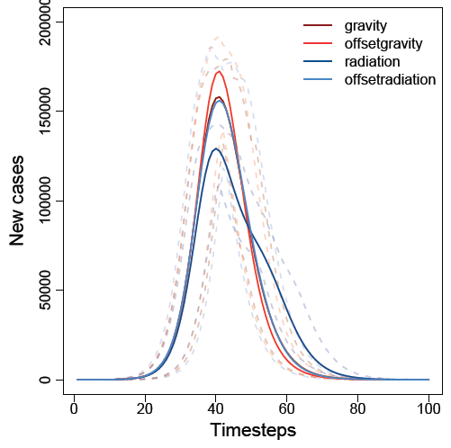
THESE DIFFERENCES ARE MATERIAL
Source: Read Mills et al, In prep.
1) but are these statistical differences important 2) we modeled spread with a high resolution metapop model rel small distance 3) still saw significant differences in the epidemic curve

Slide 29
DISCUSSION AND REFS
DISCUSSION
Kin O. Kwok, Benjamin J. Cowling, Vivian W. I. Wei, Kendra M. Wu, Jonathan M. Read, Justin Lessler, Derek A. Cummings, J.S. Malik Peiris, and Steven Riley. Social contacts and the locations in which they occur as risk factors for influenza infection. Proc Biol Sci
Kucharski AJ, Kwok KO, Wei VW, Cowling BJ, Read JM, Lessler J, Cummings DA, Riley S. The contribution of social behaviour to the transmission of influenza A in a human population. PLoS Path. June 2014. 10.1371/journal.ppat.1004206
Read JM, Lessler J, Riley S, Wang S, Tan LJ, Kwok KO, Guan Y, Jiang CQ, Cummings DA. Social mixing patterns in rural and urban areas of southern China. Proc Biol Sci. 2014 Apr 30;281(1785):20140268.
Riley S, Kwok KO, Wu KM, Ning DY, Cowling BJ, Wu JT, Ho LM, Tsang T, Lo SV, Chu DK, Ma ES, Peiris JS. Epidemiological characteristics of 2009 (H1N1) pandemic influenza based on paired sera from a longitudinal community cohort study. PLoS Med. 2011 Jun;8(6):e1000442.
1) what rel start concepts 2) social contacts don’t explain age 3) fine age group averages does work 4) social contacts can be in space 5) models with parameters are good 6) prospects for pospective

Slide 30
OBJECTIVES
Be able to describe what contact networks may or may not represent for respiratory pathogens
Be able to describe how data from contact surveys are incorporated into mathematical models
Understand what an eigen vector is and how it is useful in models with age-contact structure
Be able to describe how contact surveys can be extended to help with spatial models

Slide 31
UNUSED / BONUS SLIDES
(ONLY SLIDES PRIOR TO THIS CAN BE EXAMINED!)

Slide 32
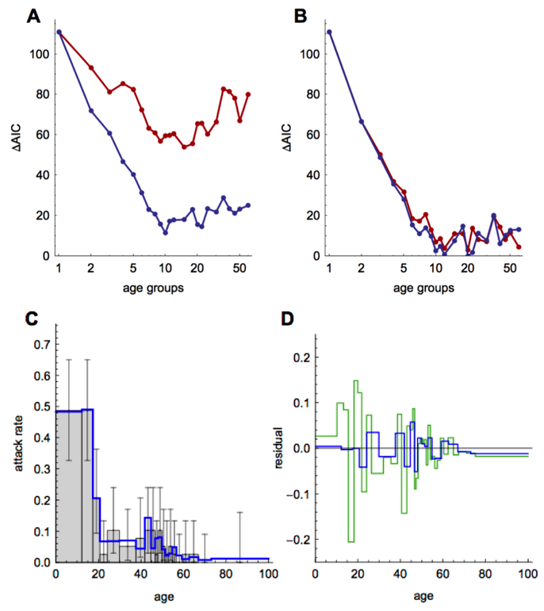
TITLE
Source: Kucharski et al, PLoS Pathogens, 2014

Slide 33
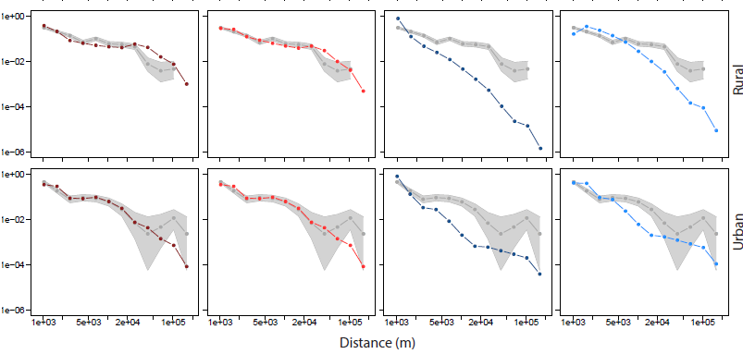
ALL STUDY PARTICIPANTS
Proportion of contacts
Source: Read Mills et al, In prep.

Slide 34
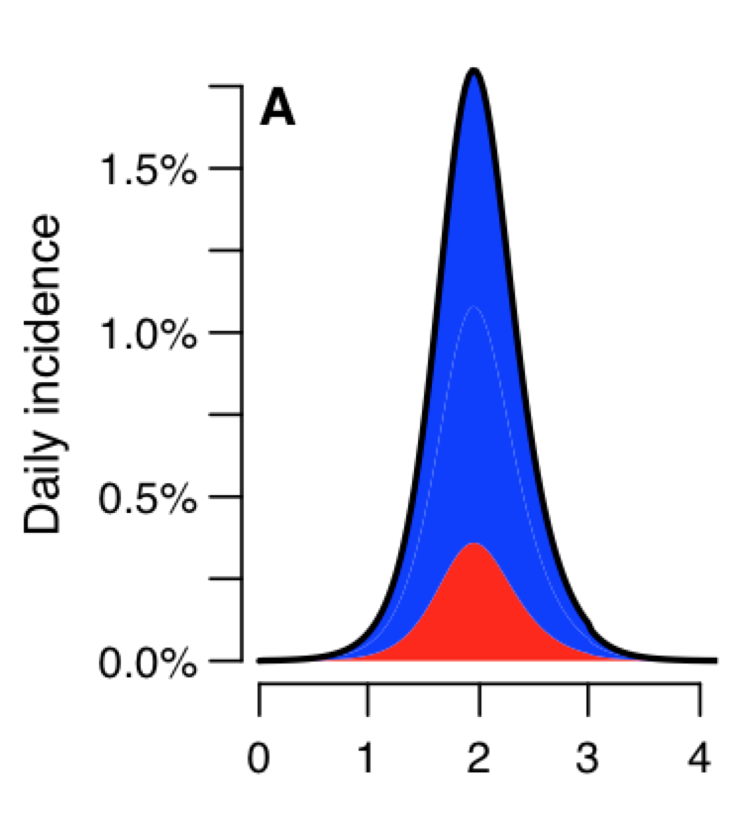
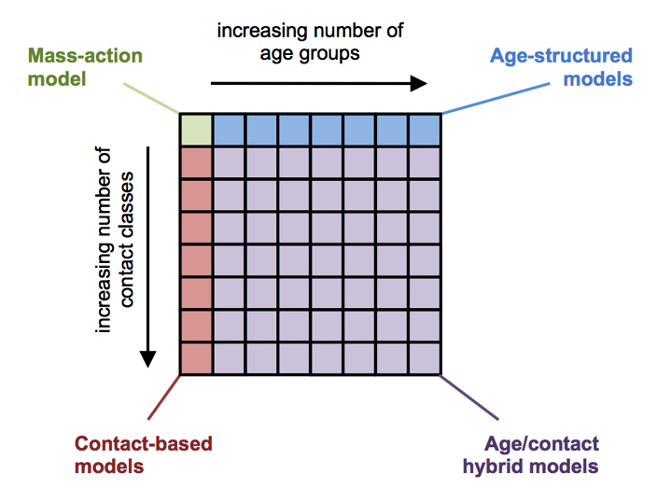
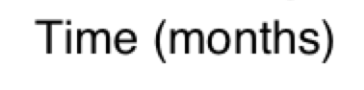
SO WE TRIED INFERENCE USING AN EPIDEMIC MODEL
Source: Kucharski et al, PLoS Pathogens, 2014
1) Imagine an epidemic model with two age classes 2) area under the curve 3) could equally be contacts 4) or both contacts and age 5) arbitrary precision

Slide 35
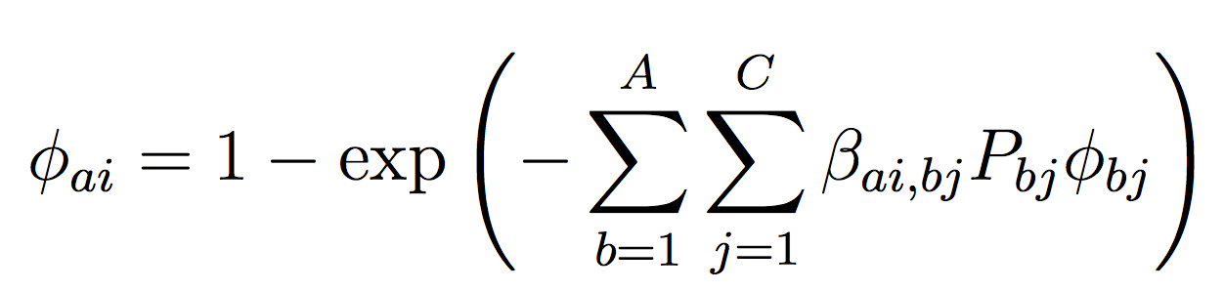
SO WE TRIED INFERENCE USING AN EPIDEMIC MODEL
Proportion
population
β_{ai,bj}=qm_{ai,bj}/P_{ai}
Coupled attack rates
Source: Kucharski et al, PLoS Pathogens, 2014. See also Riley et al PLoS Med 2008.

Slide 36
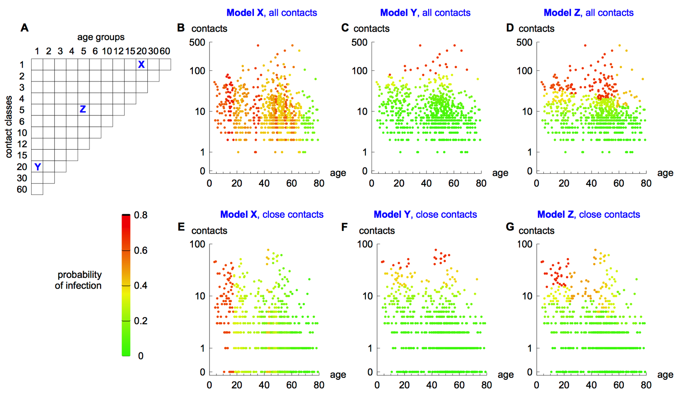
THEORETICAL IMPLICATIONS
Source: Kucharski et al, PLoS Pathogens, 2014
1) Remember my slight defensiveness 2) theoretical implications 3) no outcome data here just patterns 4) if we assume that the

Slide 37
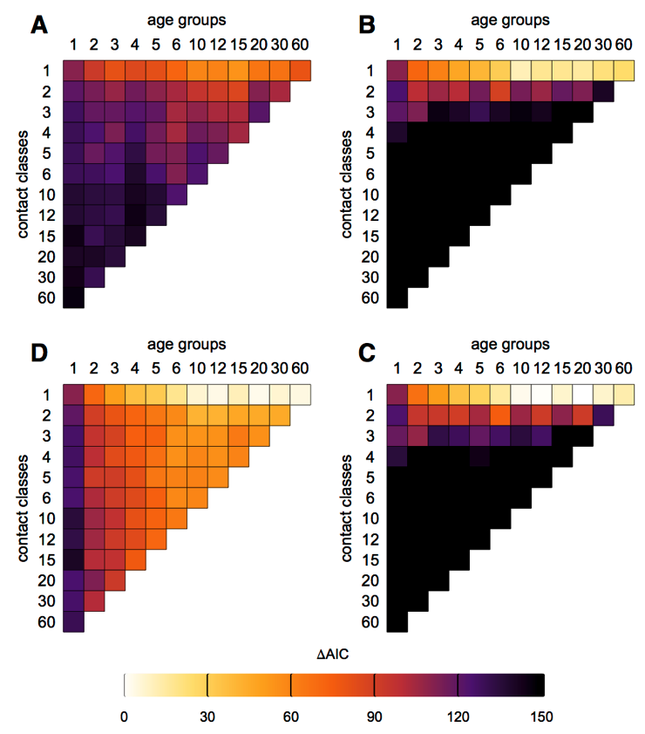
BEST MODELS DID NOT HAVE CONTACT CLASSES
Better models with age also include contact variables
but not with massive support
Age stratified data illustrates the relationship
Source: Kucharski et al, PLoS Pathogens, 2014

Slide 38
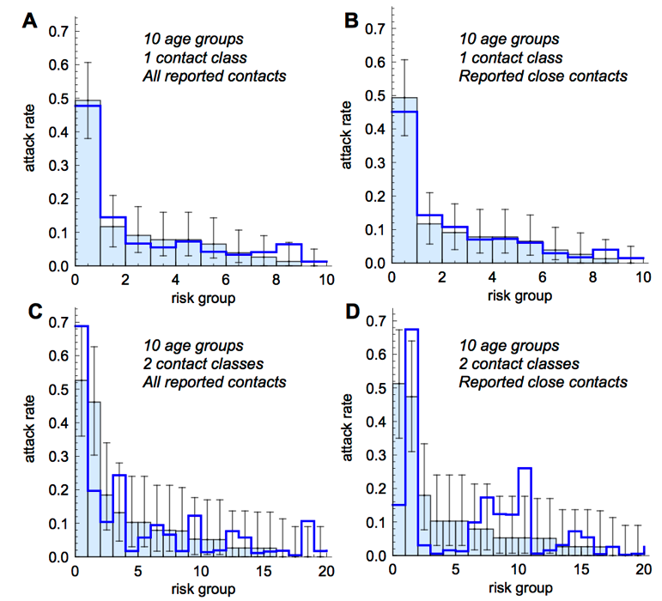
WHY DOES IT FIT BETTER?
Little evidence of contact-driven variation within ages
Risks of infection derived from average contact behavior do well
Only one parameter used here
Source: Kucharski et al, PLoS Pathogens, 2014

Slide 39
NON-SPATIAL SUMMARY
We can’t explain age away with contacts at the individual level
Fine age groups seem to give an excellent fit to the data
- Adding in one more parameter makes it even better, NOT SHOWN)
Could it be that we’re not measuring the system accurately enough?

Slide 40
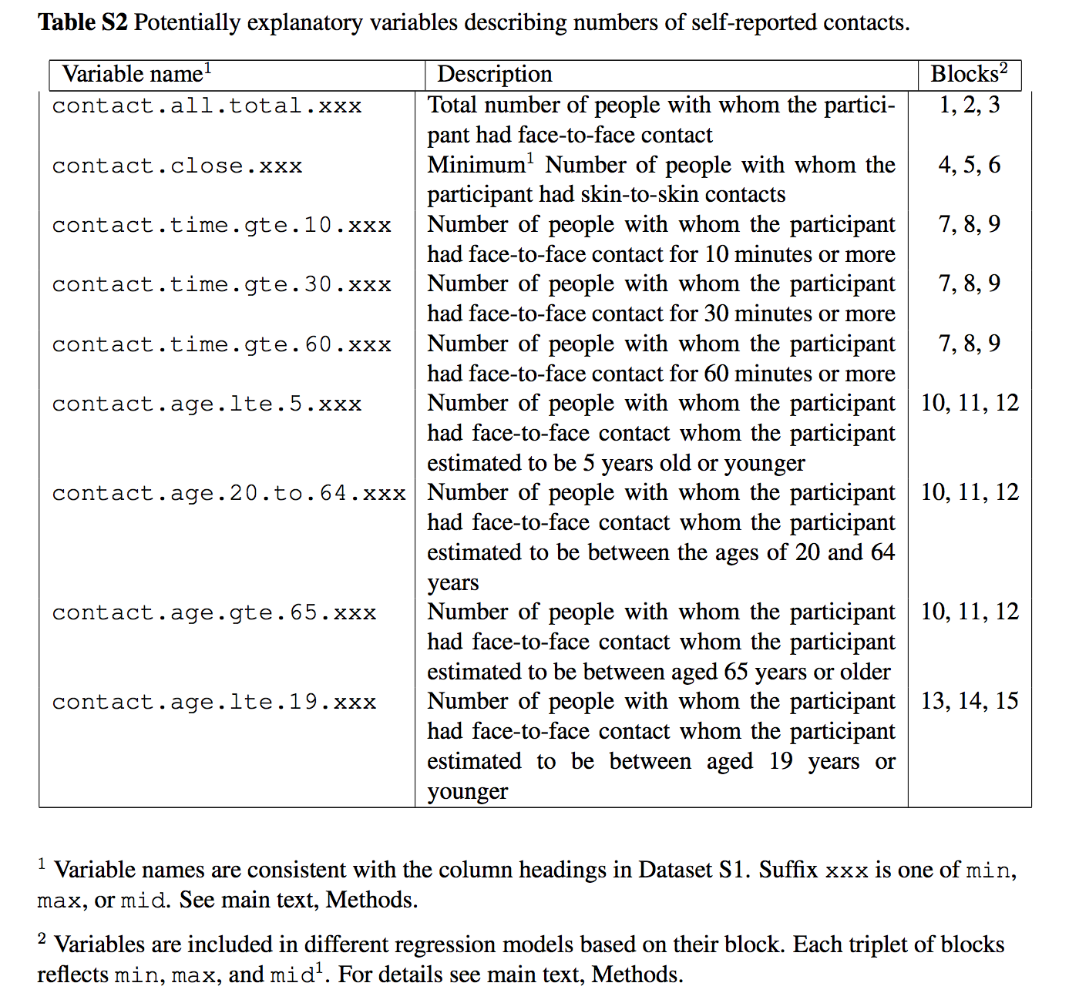
INDIVIDUAL-BASED ANALYSES
Made many variables from questionnaire
- examples
Logistic regression
Reasonable despite feedback
Best subset
Full search of model space
why ask the question!
Source: Kwok et al, Proc B, 2014

Slide 41
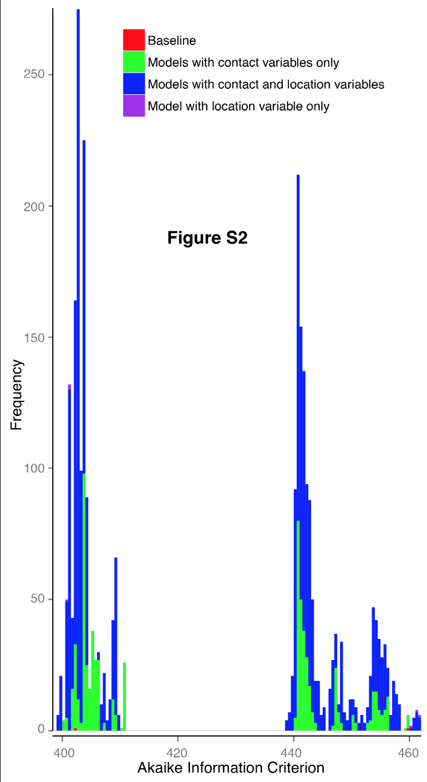
DO CONTACTS EXPLAIN AWAY AGE?
Small fonts on chart!
Baseline model as comparison
RHS versus LHS
Deviance explained
best RHS 15.7% deviance
best LHS 23.6% deviance explained
Contacts don’t explain away age
Source: Kwok et al, Proc B, 2014

Slide 42
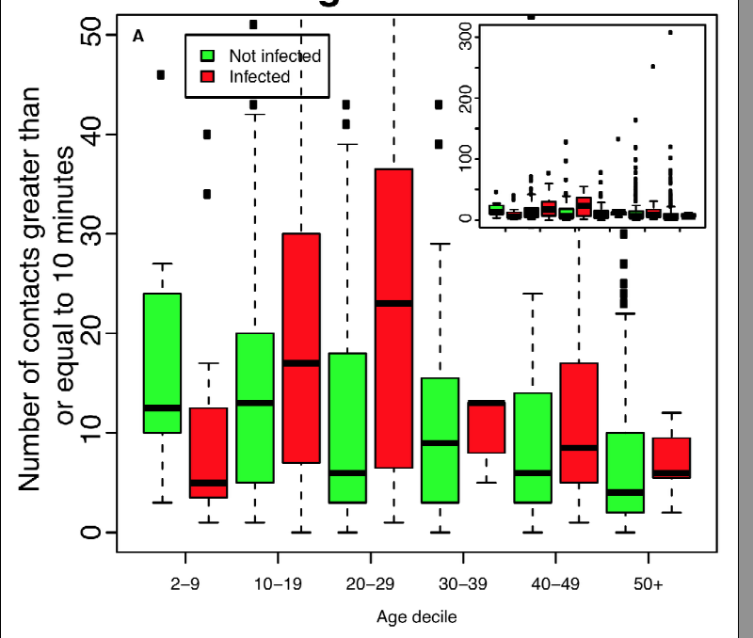
…BUT SOME EVIDENCE OF A CONTACT EFFECT
Better models with age also include contact variables
but not with massive support
Age stratified data illustrates the relationship
Source: Kwok et al, Proc B, 2014

